Slide 1


ANNUAL GENERAL MEETING
26 SEPTEMBER 2025
Annual report 2024

Slide 2
Vision & Mission
Our VISION
Leading in the achievement of a safe and caring environment for children
Our MISSION
We believe that children are our future and inspiration
We serve demarcated areas in the community of Springs & Kwa-Thema, by identifying and protecting children at risk, promoting the nurturing, education and development of children generally
We seek to reduce the risk to children by finding, mobilizing, directing and developing resources towards care, protection, education and prevention
We teach children, parents and the community the rights of children, assisting and enabling them to claim these rights
We cooperate with others to provide these services
Our services are professional, aimed at strengthening family life and focused on family preservation, applying the principles of transparency, inclusivity, accessibility and accountability

Slide 3
FROM THE DESK OF THE CHAIRPERSON
OF SPRINGS & KWA-THEMA CHILD WELFARE
9/26/2025
Greetings to all
The past 3 years have been taxing on most of the NPO’s for various reasons. In my capacity as Chairperson for our organization for numerous years now I have been dealing with many NPO’s and many of their challenges are ours as well.
We continue to hope that our challenges will abate as DSD continues to create better systems in place for the smooth operational relations between DSD and NPO’s.
We continue to have finance challenges as the DSD has tightened our budget for funding and there does
not seem like there is much place for increases in the foreseeable future putting a huge strain on our
finances as expenses go up. Coupled with this the DSD has for 2 years delayed
our funding for 2 out the 3 months which puts a huge strain on our operations and a
bad standing with our creditors. Staff could not come to work and expenses could not be paid on
time all causing delays in service delivery and getting a bad record with our creditors.

Slide 4
FROM THE DESK OF THE CHAIRPERSON
OF SPRINGS & KWA-THEMA CHILD WELFARE
Even though the Department of Social Development pays their tranches late we are truly grateful for their contribution not only in the funding, but the help they give us in solving some our challenges.
We have also had to do some essential building and equipment maintenance as the building and equipment is beginning to show its age which has put a further strain on our budget. We would like to thank all the board members this past year for their commitment and dedication in keeping our organization running And our staff for their dedication and loyal years of service to the organisation for without them we wouldn’t be where we are today
For those interested in joining our team through “joining hands” we have a needs list that you can help us with. You can do so by giving a donation to a specific need or you can help by donating your specific “services” or by even putting us in contact with someone who would be interested in helping us. If interested please give your name to Rose at the end of our AGM meeting thank you for your support.
Greetings from your faithful servant
Dario Froli
Chairperson

Slide 5



Slide 6

Program Manager’s Overview 2024-2025
As the previous financial year ended the new financial year continued to be very challenging due to the subsidy payments being very late and staff and the beneficiaries suffering
Being a Child Welfare organisation it reiterates the fact that our core business is children and their protection and when we are unable to fulfil that responsibility we are indirectly failing the children in our communities…we constantly hear endless messages from the Government of the importance of our services to them and that we are partners, yet NO NPO feels appreciated or being consulted as partners are supposed to engage with one another when changes are made or what progress is made…despite this we work well along with the local Departmental Officials
The Gauteng Care Crisis Committee (GCCC) which was formalised in 2024 is still fighting for the survival of NPOs and social care services to children, people with disabilities, older persons, and other vulnerable groups who require food, housing, safety and protection, and specialized supportive and therapeutic interventions. Webber & Wentzel attorneys joined the fight and took
hands with the NPOs against the Government and to
ensure they fulfil their constitutional obligation
to ensure service delivery to vulnerable
persons and children

Slide 7
Program Manager’s Overview 2023-2024 continues…..
Program Manager’s Overview 2024-2025
This situation led to the organisation’s physical closure of the office again from 30 April 2024 with the staff divided
into groups and working 1 day per week, until the subsidy was paid in. Luckily this resulted in the subsidy being
paid within days. Money was borrowed to pay the staff their salaries for April 2024. the 1st tranche of subsidy
was only paid in on 3/6/2024 and staff were immediately paid and borrowed money returned to the lender.
The funding thankfully remained the same as the previous year otherwise retrenchments would have had to be
considered.
We had 2 resignations as 1 of the Social Auxiliary Workers finally concluded her SW studies and when a Social Worker became available she resigned from her SAW and that post became vacant. Due to all the uncertainty the SAW post was not filled immediately, but on 2024/06/25 we were instructed that the SAW must be filled by 28/6/2024. A SAW was then appointed on 28/06/2024, on a 3 monthly contract, which was renewed as long as the subsidy was paid. The Department of Social Development, Springs, then again had not paid over the 2nd quarter payment and the office was forced to close temporarily again from 29/7/2025. On 2/8/2024 the subsidy was however paid over for the 2nd and 3rd tranche, which has never happened before. This however ensured there were funds until 31/12/2024 at least. The staff was only then paid for July 2024. This affected the beneficiaries adversely as they then had limited days to see the SW and some SWs could not attend Court during there temporary closures and court matters had to be postponed unduly. The Court would then had to refer new Form 2s to DSD. All progress reports were sent to Sanet via WhatsApp and then Sanet appeared on behalf of the staff to obtain new dates. These periods of no remuneration also left the staff despondent and demotivated and in dire need themselves. This blatant disrespect for the staff’s diligent work ethics causes them anguish and frustration. All the staff’s commitment is commended despite the dire situation we find ourselves in from time to time, due to the late payments. The staff should be commended for the continued holding of my hand as well as that of their colleagues. I am always proud to be your supervisor and appreciate you all more that you will ever know….

Slide 8
Program Manager’s Overview continues...
Mr Matwadia was appointed at the Children’s Court in May 2024. The lack of finances was discussed with him personally and he was requesting that the staff only attend matters when they are due to be concluded. An agreement was reached that progress reports will be handed in personally by Sanet and no attendance will be needed, unless a matter is ready to be concluded. He was not keen on sending all new matters to DSD and we agreed the urgent ones he will send to DSD, but the ones which are not deemed urgent by him will be postponed to a date in May 2024 and when by 1/5/2024 the situation has not been resolved either postpone it again or redesignate to DSD. An email was drafted to this effect and shared with all stakeholders in the immediate vicinity of the organisation, every time when a lack of funding interfered with service delivery.
During 2024-2025 8 foster care placements involving 10 children were done As the figures shown in the last financial year the figures have dropped immensely as the DSD informed the Court from 20/8/2024 the NPOs were no longer allowed to do new foster care placements. This lead to an increase in Primary Care placements and Guardianship placements that are being forced upon the applicants in stead of foster care placements that would allow them financial assistance as well. The Society appreciates all the efforts made by Mr Matwadia by assisting the all the children being placed in foster care and other alternative care. Many of the backlog cases was dealt with without a need to legalise the placement as the family or child had relocated and services are no longer required. DSD then changed the legislation regarding adverts in August 2024 for tracing missing parents…It now needed to be a notice given to the canalization officer, who has to follow a process of emails to have it be placed on DSD’s website and displayed at the offices of the NPO. When it was said to start their processes had not even been concluded and this also delayed matters being concluded timeously. It was reported that there is a possibility of Mrs. Francis returning to Children’s Court in May 2025 and she will be welcomed with open arms and grateful hearts as we all respect each other and work well together
Forms 2’s were still received on a regular basis from the Court requesting assistance with Section 23 (Primary Care) & Section 24 (Guardianship) placements, parenting plans requiring mediation, investigations needed to determine whether children are in need of care and protection, termination of parental rights and responsibilities, ect.

Slide 9

Program Manager’s Overview 2024-2025 continue..
We are in a profession where we touch people’s lives daily in one way or another and
we give so much of ourselves, in everything we do and it sometimes ends in burnout,
which we should all work hard to prevent by doing self-care, know your limits and when
your body needs to rest…
Challenges will always be there in one way or another as we have to deal with many resources such as SAPS, the Department of Social Development, the Department of Justice,
the Department of Home Affairs, the Department of Education and others to mention but a few…
In general, we have built good relationships with most the resources in the
community and some we even have on speed dial for those days when a child/ren
need assistance in one way or another…

Slide 10
Program Manager’s Overview continues...

Slide 11




Service Delivery
Remains on FOUR levels
        Prevention
        Provision of intake services at the Springs office,
        Kwa-Thema (HH Ngakane Centre – twice a week) & Bakerton Center (once a week)
        Early intervention
        Court ordered investigations of children in need of care, parenting plans and mediation. Gaurdianship is an added order the Children’s Court is allowed to make
        Statutory
        Removal, placement & after care services to children in alternate care as per the guidelines set out in terms of the Children’s Act 38/2005, as amended
        Development
        Through allowing registered Social Auxiliary Work and Social Work students as well as Counselling Psychologists to obtain practical experience by observation and participation when certain programmes are being presented

Slide 12
Service Delivery continues….some outcomes
The abandoned baby who was found under the tree in front of the office on 8/7/2022 has found a loving
family in Tsakane on his placement was concluded on 16 April 2024
The staff has been able to assist a number of babies and older children getting birth certificates and ID cards
when the parents deliberately neglected their responsibilities in ensuring the children’s registration within
30 days of birth or getting an ID at the age of 16
Unfortunately, a baby of 23 months removed due to having been neglected since March 2022 when his mother
left him with an undocumented person abusing drugs and alcohol and feeding the child whisky and sleeping
tablets. Child was filthy and needed to look after himself and not disturb her. He was placed in a Child and
Youth Care Centre, where he has developed well and attending créche and his placement will be concluded soon
Two coloured girls were removed from foster care and placed at the hostel of the school they are attending as
their behaviour suddenly became challenging at school. After a lengthy conversation the 1 child disclosed inappro-
privately being touched by the foster father; they were successfully integrated into the hostel and weekend
parents was arranged with the view of transferring the child to their care

Slide 13
Challenges
Financial stability and sustainability remains a constant challenge, which has impacts negatively on
the day-to-day service delivery again resulting in loans to remunerate the staff, where possible
The vehicles are sporadically giving problems due to wear and tear and the funds to fix the cars are limited
The Board still requires to be expanded, have a broader representation and acquire more expert skilled Management members from different race groups – e.g. IT skills, Project Planning (buildings), assistance with proposal writing to corporates to obtain financial assistance to come on board and assist as board members to make important decisions regarding the financial management of the Society. If anyone thus knows of a person/s that can add value to the organization they can bring their CV’s and they will be interviewed to assess what skills they have that can contribute and add value to the Board…
There is a desperate need for a full-time fundraiser as it is becoming increasingly difficult to raise funds to assist when the subsidy is not paid in on time… there is a volunteer who has been approached and agreed to sort the donations and get the charity shop functioning in an attempt to obtain a monthly source of income
Continued financial support from community members and corporates are needed to assist with operational expenditure. The Society is registered to issue a Section 18A certificate for Tax Exemption purposes

Slide 14

Objectives 2024-2025
GOVERNANCE & FINANCIAL
Ensuring responsible governance
Securing financial support towards Organizational survival and growth
SERVICE DELIVERY
Attempt to request assistance from corporates to sponsor the employment of
registered Social Workers on a contract basis to assist with the eradication of the
increasing foster care backlog
Striving to continuously providing quality service delivery
Ensuring compliance to minimum norms & standards & code of ethics
EMPLOYEE CAPACITY BUILDING
Continued mentoring and skills development of professional staff where possible
Enhancing sharing of knowledge
Retaining skills and knowledge
ASSISTANCE TO SOCIAL WORK AND SOCIAL AUXILAIRY WORK STUDENTS & COUNSELLING PSYCHOLOGIST STUDENTS
Providing them with a platform where they can experience the practical work in comparison and relation to the
theory which does not prepare any person for actually doing the work in the community, especially the Social Work
students. The staff is very involved with providing experience to the students they would only learn at NGO’s like
Child Welfare. 2 Counselling Psychologist have done their hours with the organisation and it was deemed needed

Slide 15
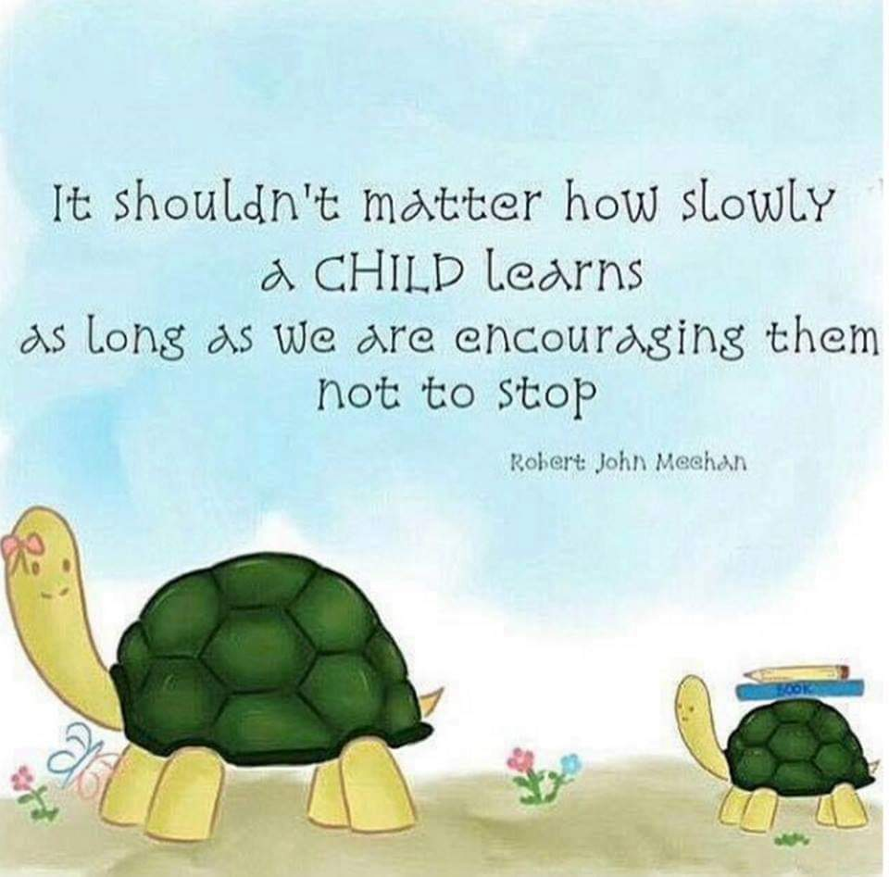
Program Manager’s Overview continues...
As staff we spend many hours together daily and have always
been known for being willing to make all the pieces of the
puzzle fit together when they take hands in all
situations in the workplace and in their personal lives
Together we are each other’s strength and we learn new things, while
supporting one another on all levels....we encouarage one another
the aim is always to ensure we do our best with what is available at
the time..
Thank you to all the family members at Springs Child Welfare for sharing your lives with one another
on a daily basis and being
each other’s pillars of strength

Slide 16


TOGETHER WE CAN ACHIEVE MUCH MORE THAN SEPARATELY…LET’S NEVER LET GO OF THE HAND THAT HOLDS OURS SO FIRMLY
AND
GIVE GOD ALL THE GLORY

Slide 17
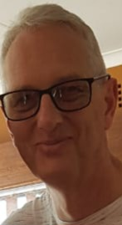

Gratitude
We are grateful for the financial assistance received from various donors:
Dirk Du Toit for giving a fixed amount for the past 9 years,
which has made such a difference when things become dire and funds were needed…
words can never express how grateful we are
Gerrit van Moerkerken, who helped with interest free loans when the subsidy from the
Department of Social Development was paid late or not at all.
The staff thanks you from the bottom of their hearts
Lastly, I would like to verbalize my gratitude to the Board of
Management that have so diligently supported myself and the staff
throughout the year, with all it’s highs and lows.. Who has always
attempted to ensure the staff is made to feel appreciated for their
efforts and dedication...It is appreciated more than you know…..

